Slide 1


Chapter 4: Routing Concepts
Routing Protocols
Notes:
Cisco Networking Academy program
Routing Protocols
Chapter 4: Routing Concepts

Slide 2
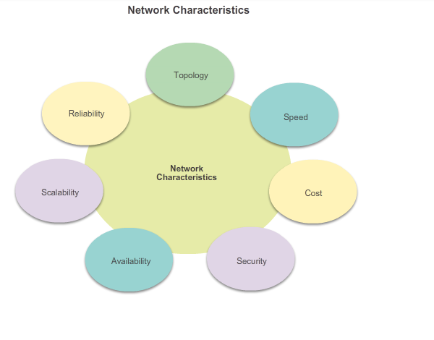
Functions of a Router Characteristics of a Network
As shown in the figure, there are many key structures and performance-related characteristics referred to when discussing networks:
These characteristics and attributes provide a means to compare different networking solutions.
Notes:
4.1 Initial Router Configuration
4.1.1 Function of a Router
4.1.1.1 Characteristics of a Network

Slide 3
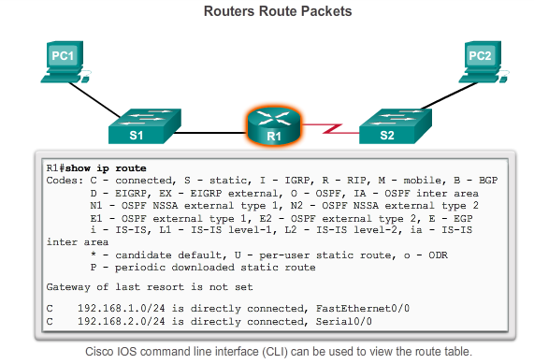
Functions of a Router Why Routing?
The router is responsible for the routing of traffic between networks (from one LAN to another or from one subnet to another or from one VLAN to another).
A router is a Layer3 Device.
Communication between networks would not be possible without a router determining the best path to the destination and forwarding traffic to the next router along that path.
Notes:
Function of a Router
4.1.1.2 Why Routing?

Slide 4
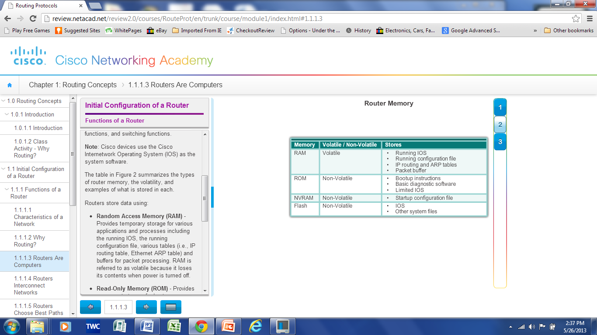
Functions of a Router Routers are Computers
Routers are specialized computers containing the following required components to operate:
Central processing unit (CPU)
Operating system (OS) - Routers use Cisco IOS
Memory and storage (RAM, ROM, NVRAM, Flash, hard drive)
Routers utilize the following memory:
Notes:
Functions of a Router
4.1.1.3 Routers are Computers

Slide 5
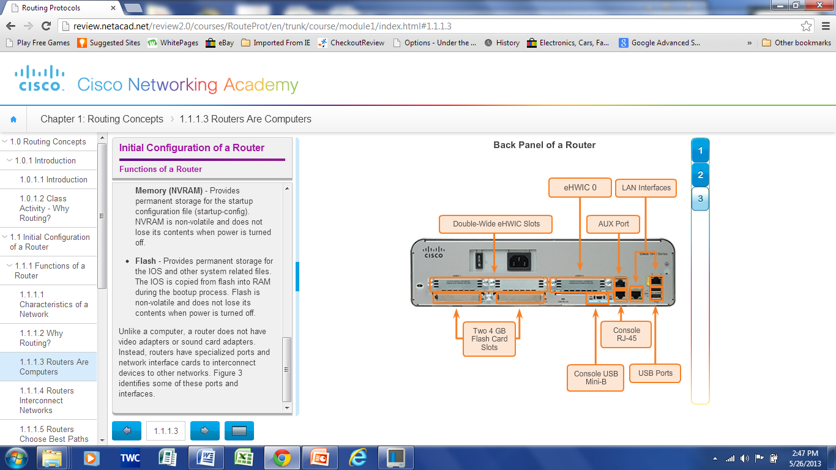
Functions of a Router Routers are Computers
Routers use specialized ports and network interface cards to interconnect to other networks
LAN Connections
WAN Connections
Notes:
Functions of a Router
4.1.1.3 Routers are Computers

Slide 6
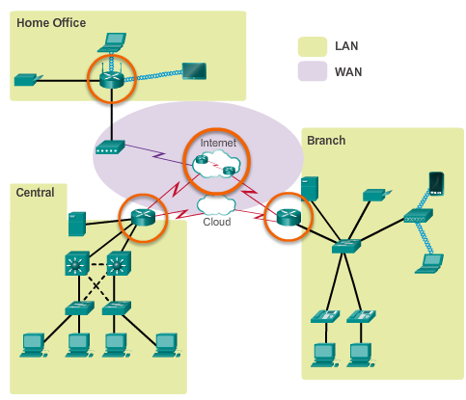
Functions of a Router Routers Interconnect Networks
Routers can connect multiple networks.
Routers have multiple interfaces, each on a different IP network.
When a packet arrives on a router interface, the router uses its routing table to determine how to reach the destination network.
Notes:
Functions of a Router
4.1.1.4 Routers Interconnect Networks

Slide 7
Functions of a Router Routers Choose Best Paths
Determine the ”best” path to send packets
Uses its routing table to determine path
Forward packets toward their destination
(Like a Postal sorting Office)
Forwards packet to interface indicated in routing table.
Encapsulates the packet and forwards out toward destination.
Routers use static routes and dynamic routing protocols to learn about remote networks and build their routing tables.
Notes:
Functions of a Router
4.1.1.5 Routers Choose Best Paths

Slide 8
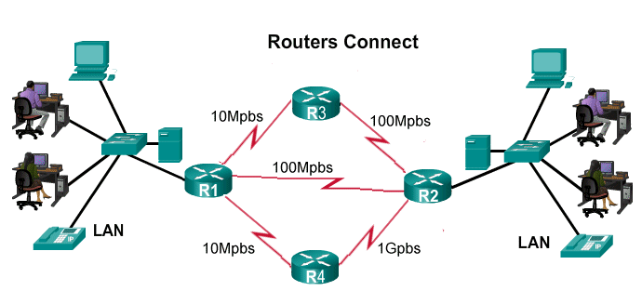
Functions of a Router Routers Choose Best Paths

Slide 9
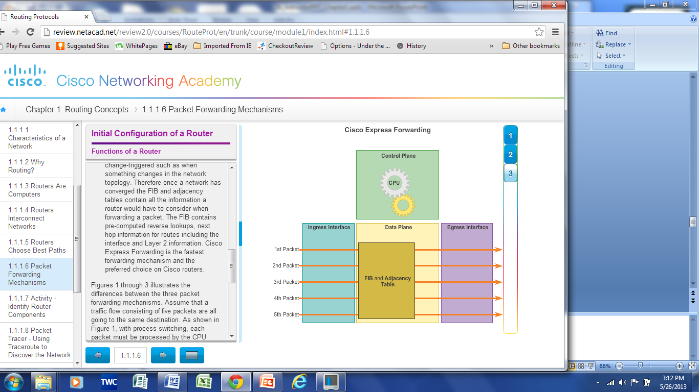
Functions of a Router Packet Forwarding Methods
Routers support three packet-forwarding mechanisms:
Process switching
Fast switching
Cisco Express Forwarding (CEF)
Notes:
Functions of a Router
4.1.1.6 Packet Forwarding Methods
4.1.1.7 Activity – Identify Router Components
4.1.1.8 Packet Tracer – Using Traceroute to Discover Networks
4.1.1.9 Lab – Mapping the Internet

Slide 10
Functions of a Router Packet Forwarding Method Process Switching
An older packet forwarding mechanism still available for Cisco routers.
When a packet arrives on an interface, it is forwarded to the control plane where the CPU matches the destination address with an entry in its routing table, and then determines the exit interface and forwards the packet.
It is important to understand that the router does this for every packet, even if the destination is the same for a stream of packets. This process-switching mechanism is very slow and rarely implemented in modern networks.
Notes:
Functions of a Router
4.1.1.6 Packet Forwarding Methods
4.1.1.7 Activity – Identify Router Components
4.1.1.8 Packet Tracer – Using Traceroute to Discover Networks
4.1.1.9 Lab – Mapping the Internet

Slide 11
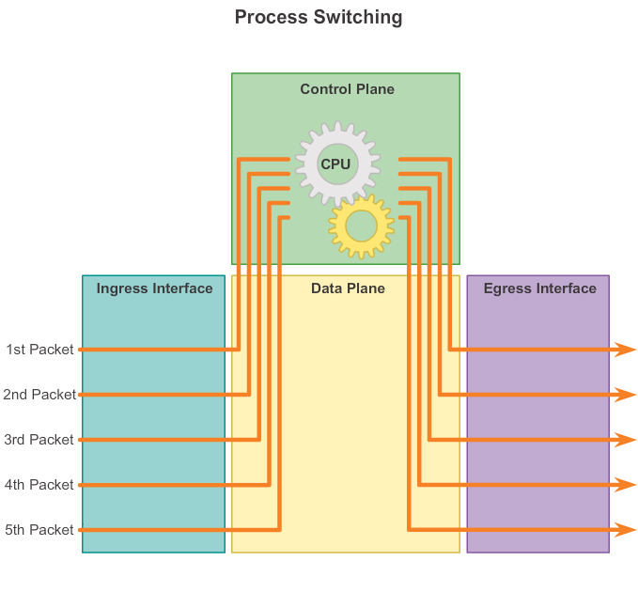
Functions of a Router Packet Forwarding Method Process Switching
Notes:
Functions of a Router
4.1.1.6 Packet Forwarding Methods
4.1.1.7 Activity – Identify Router Components
4.1.1.8 Packet Tracer – Using Traceroute to Discover Networks
4.1.1.9 Lab – Mapping the Internet

Slide 12
Functions of a Router Packet Forwarding Methods: Fast switching
A common packet forwarding mechanism which uses a fast-switching cache to store next hop information.
When a packet arrives on an interface, it is forwarded to the control plane where the CPU searches for a match in the fast-switching cache.
If it is not there, it is process-switched and forwarded to the exit interface.
The flow information for the packet is also stored in the fast-switching cache.
If another packet going to the same destination arrives on an interface, the next-hop information in the cache is re-used without CPU intervention.
Notes:
Functions of a Router
4.1.1.6 Packet Forwarding Methods
4.1.1.7 Activity – Identify Router Components
4.1.1.8 Packet Tracer – Using Traceroute to Discover Networks
4.1.1.9 Lab – Mapping the Internet

Slide 13
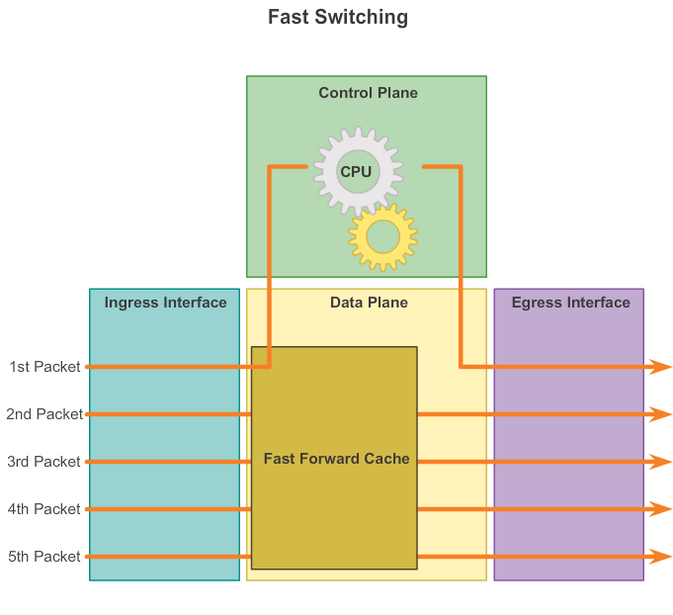
Functions of a Router Packet Forwarding Methods: Fast switching
Notes:
Functions of a Router
4.1.1.6 Packet Forwarding Methods
4.1.1.7 Activity – Identify Router Components
4.1.1.8 Packet Tracer – Using Traceroute to Discover Networks
4.1.1.9 Lab – Mapping the Internet

Slide 14
Functions of a Router Packet Forwarding Methods: Cisco Express Forwarding (CEF)
CEF is the most recent and preferred Cisco IOS packet-forwarding mechanism.
Like fast switching, CEF builds a Forwarding Information Base (FIB), and an adjacency table.
However, the table entries are not packet-triggered like fast switching but change-triggered such as when something changes in the network topology.
Therefore, when a network has converged, the FIB and adjacency tables contain all the information a router would have to consider when forwarding a packet.
The FIB contains pre-computed reverse lookups, next hop information for routes including the interface and Layer 2 information.
Cisco Express Forwarding is the fastest forwarding mechanism and the preferred choice on Cisco routers.
Notes:
Functions of a Router
4.1.1.6 Packet Forwarding Methods
4.1.1.7 Activity – Identify Router Components
4.1.1.8 Packet Tracer – Using Traceroute to Discover Networks
4.1.1.9 Lab – Mapping the Internet

Slide 15
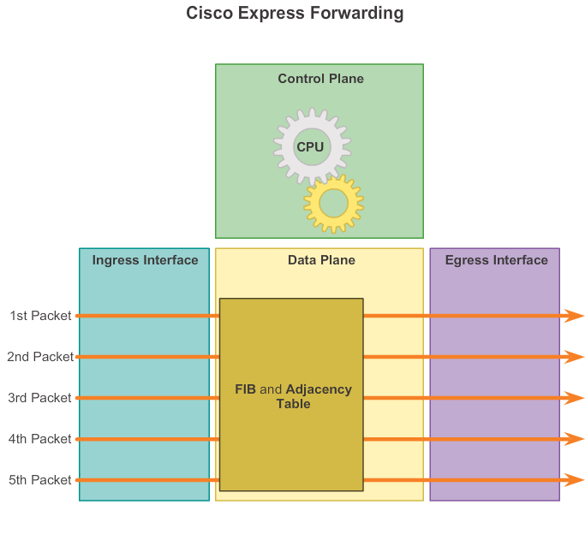
Functions of a Router Packet Forwarding Methods: Cisco Express Forwarding (CEF)
Notes:
Functions of a Router
4.1.1.6 Packet Forwarding Methods
4.1.1.7 Activity – Identify Router Components
4.1.1.8 Packet Tracer – Using Traceroute to Discover Networks
4.1.1.9 Lab – Mapping the Internet

Slide 16
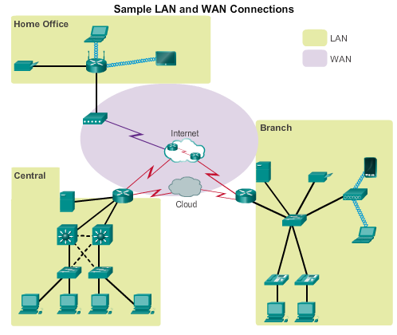
Connect Devices Connect to a Network
Wireless Router
Network devices and end users typically connect to a network using a wired Ethernet or wireless connection.
Refer to the figure as a sample reference topology. The LANs in the figure serve as an example of how users and network devices could connect to networks.
DSL Modem
Wireless Access Point
L3 Switch
Notes:
4.1.2 Connect Devices
4.1.2.1 Connect to a Network

Slide 17
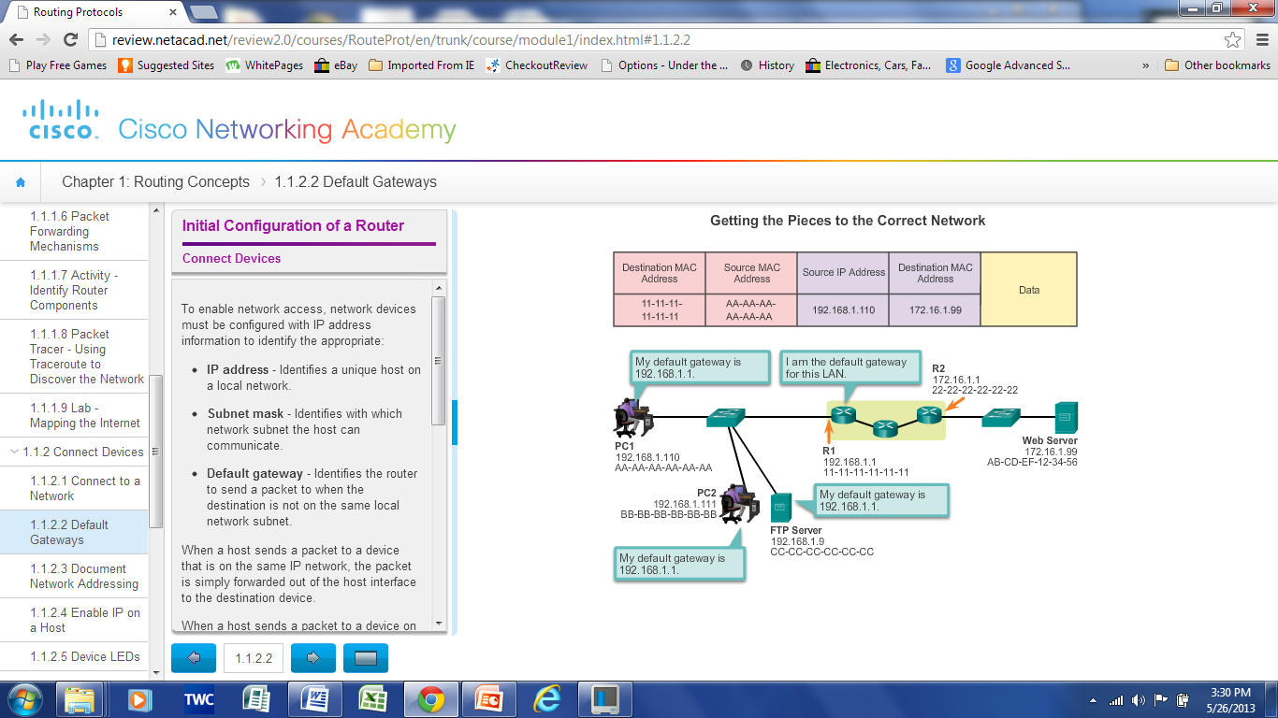
Connect Devices Default Gateways
To enable network access devices must be configured with the following IP address information
IP address - Identifies a unique host on a local network.
Subnet mask - Identifies the host’s network subnet.
Default gateway - Identifies the router a packet is sent to to when the destination is not on the same local network subnet.
Notes:
4.1.2 Connect Devices
4.1.2.2 Default Gateways

Slide 18
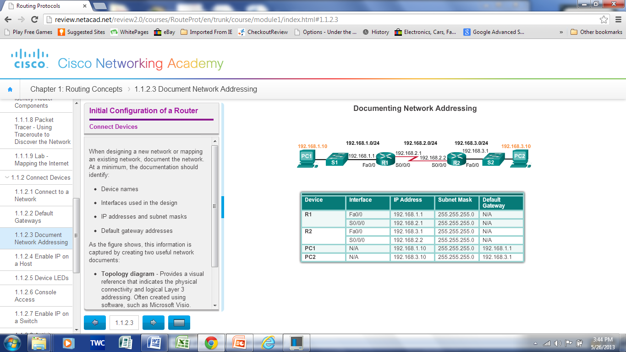
Connect Devices Document Network Addressing
Network Documentation should include at least the following in a topology diagram and addressing table:
Device names
Interfaces
IP addresses and
subnet mask
Default gateways
Notes:
4.1.2 Connect Devices
4.1.2.3 Document Network Addressing

Slide 19
Connect Devices Enable IP on a Host
Statically Assigned IP address – host is manually assigned the IP address, subnet mask and default gateway. DNS server IP address can also be assigned.
Used to identify specific network resources such as network servers and printers
Can be used in very small networks with few hosts.
Dynamically Assigned IP Address – IP Address information is dynamically assigned by a server using Dynamic Host Configuration Protocol (DHCP)
Most hosts acquire their IP address information through DHCP
DHCP services can be provided by Cisco routers
Notes:
4.1.2 Connect Devices
4.1.2.4 Enable IP on a Host

Slide 20
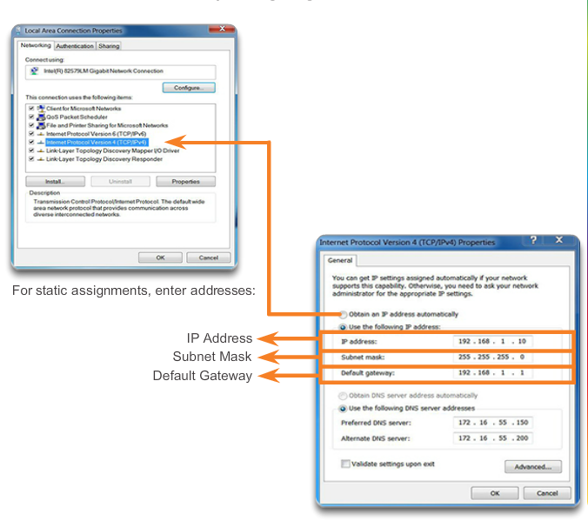
Connect Devices Enable IP on a Host

Slide 21
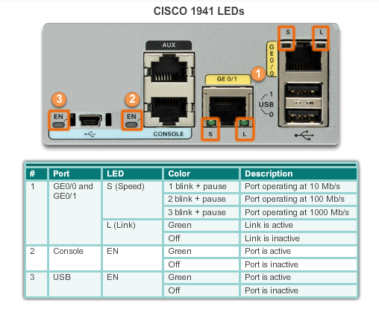
Connect Devices Device LEDs
Notes:
4.1.2 Connect Devices
4.1.2.5 Device LEDs

Slide 22
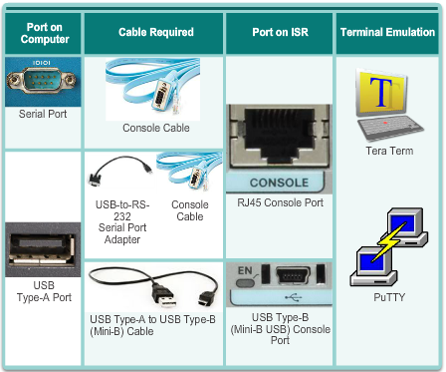
Connect Devices Console Access
Console access requires:
Console cable – RJ-45-to-DB-9 console cable
Terminal emulation software – Tera Term, PuTTY, HyperTerminal
Notes:
4.1.2 Connect Devices
4.1.2.6 Console Access

Slide 23
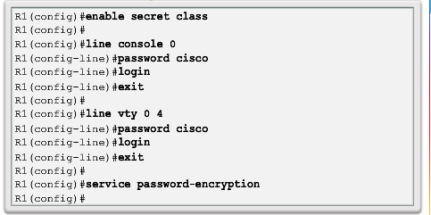
Basic Settings on a Router Configure Basic Router Settings
Basics tasks that should be first configured on a Cisco Router and Cisco Switch:
Name the device – Distinguishes it from other routers
Secure management access – Secures privileged EXEC, user EXEC, and Telnet access, and encrypts passwords to their highest level
Configure a banner – Provides legal notification of unauthorized access.
Notes:
4.1.3 Basic Settings on a Router
4.1.3.1 Configure Basic Router Settings

Slide 24
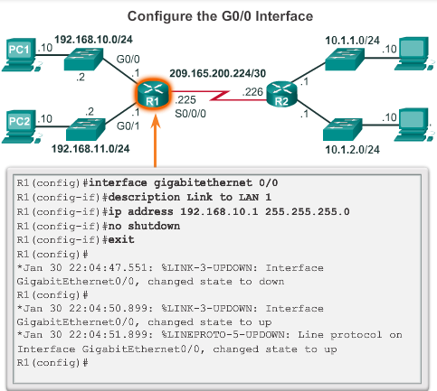
Basic Settings on a Router Configure Router Interfaces
To be available a router interface must be:
Configured with an address and subnet mask .
Activated – by default LAN and WAN interfaces are not activated. Must be activated using no shutdown command.
Other parameters - serial cable end labeled DCE must be configured with the clock rate command.
Optional description can be included.
Notes:
4.1.3 Basic Settings on a Router
4.1.3.3 Configure Router Interfaces

Slide 25
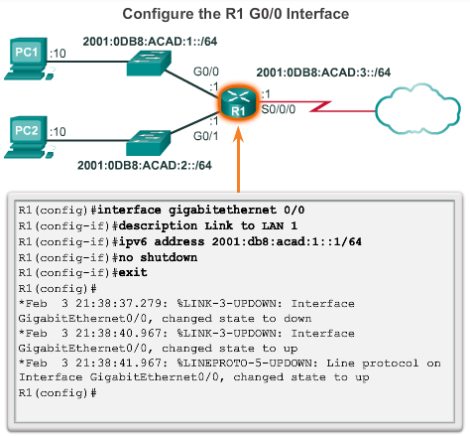
Basic Settings on a Router Configure an IPv6 Router Interface
Configure interface with IPv6 address and subnet mask. Use the ipv6 address ipv6-address/ipv6-length [link-local | eui-64]interface configuration command.
Activate – using no shutdown command.
IPv6 interfaces can support more than one address:
Configure a specified global unicast - ipv6-address /ipv6-length .Configure a global IPv6 address with an interface identifier (ID) in the low-order 64 bits - ipv6-address /ipv6-length eui-64
Configure a link-local address - ipv6-address /ipv6-length link-local
Notes:
4.1.3 Basic Settings on a Router
4.1.3.3 Configure an IPv6 Router Interface

Slide 26
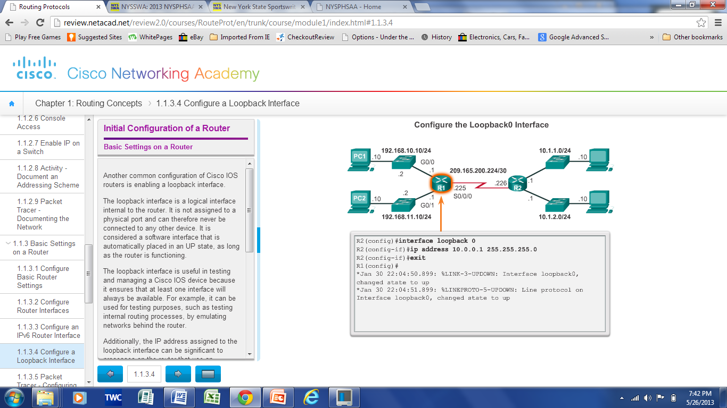
Basic Settings on a Router Configure a Loopback Interface
Loopback interface is a logical interface internal to the router.
It is not assigned to a physical port, it is considered a software interface that is automatically in an UP state.
Useful for testing and important in the OSPF routing process.
Notes:
4.1.3 Basic Settings on a Router
4.1.3.4 Configure a Loopback Interface
4.1.3.5 Packet Tracer – Configuring IPv4 and IPv6 Interfaces

Slide 27
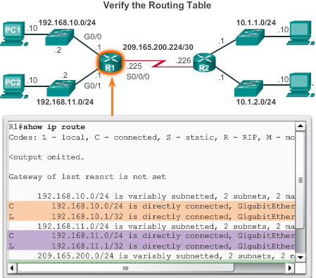
Verify Connectivity of Directly Connected Networks Verify Interface Settings
Show commands to verify operation and configuration of interface.
show ip interfaces brief
show ip route
show running-config
Show commands to gather more detailed interface information.
show interfaces
show ip interfaces
Notes:
4.1.4 Verify Connectivity of Directly Connected Networks
4.1.4.1 Verify Interface Settings

Slide 28
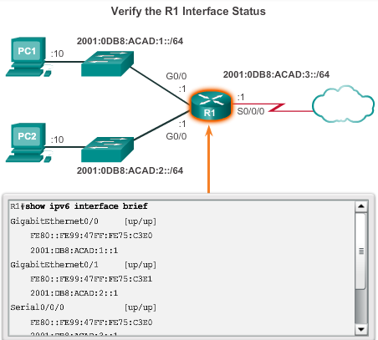
Verify Connectivity of Directly Connected Networks Verify Interface Settings
show ipv6 interface brief - displays a summary for each of the interfaces.
show ipv6 interface gigabitethernet 0/0 - displays the interface status and all the IPv6 addresses for this interface.
show ipv6 route - verify that IPv6 networks and specific IPv6 interface addresses have been installed in the IPv6 routing table.
show interface
show ipv6 routers (To display IPv6 router advertisement (RA) information received from on-link devices,)
Notes:
4.1.4 Verify Connectivity of Directly Connected Networks
4.1.4.2.Verify IPv6 Interface Settings

Slide 29
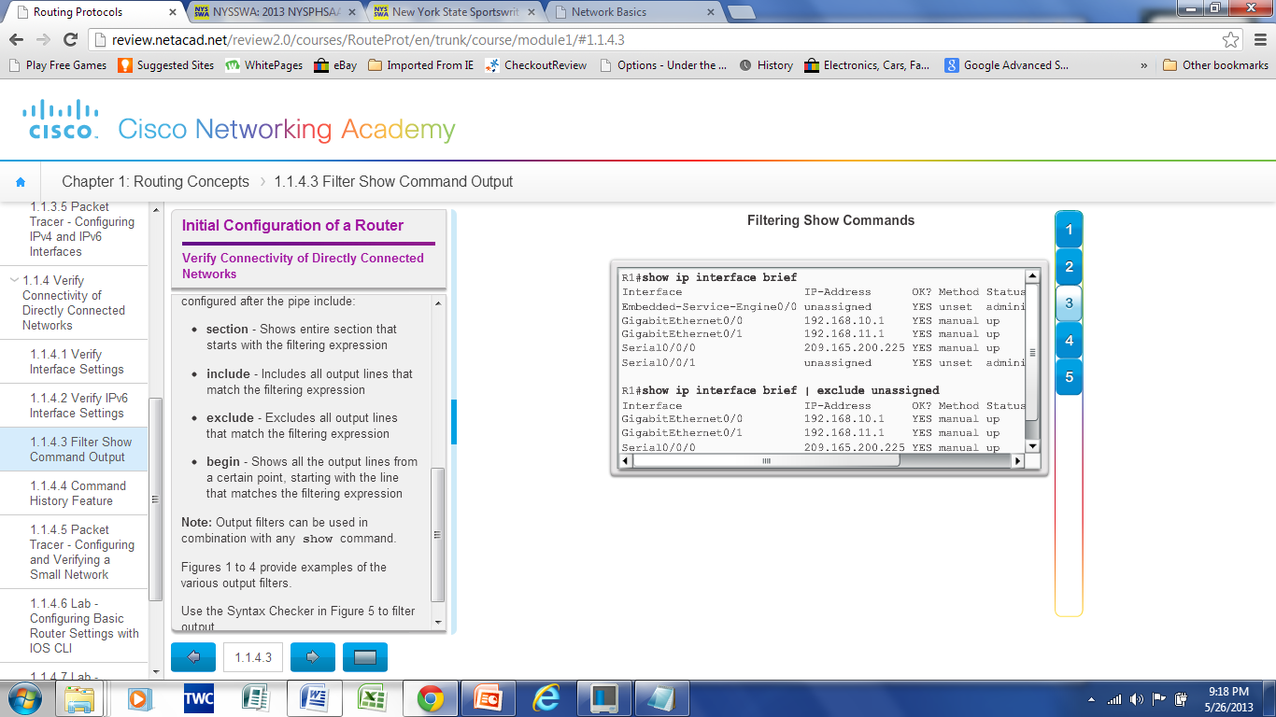
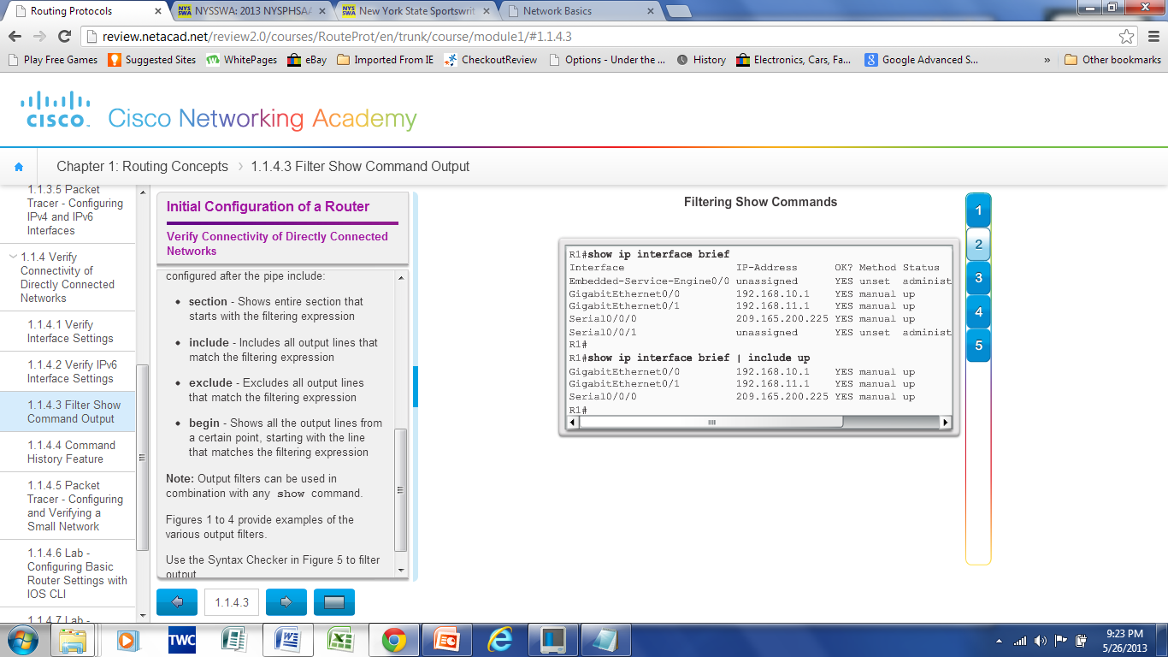
Verify Connectivity of Directly Connected Networks Filter Show Command Output
Use the terminal lengthnumbercommand to specify the number of lines to be displayed. A value of 0 (zero) prevents the router from pausing between screens of output.
To filter specific output of commands use the (|)pipe character after show command. Parameters that can be used after pipe include:
section, include, exclude, begin
Notes:
4.1.4 Verify Connectivity of Directly Connected Networks
4.1.4.3 Filter Show Command Output

Slide 30
Verify Connectivity of Directly Connected Networks Command History Feature
Recall commands – Ctrl+P or the UP Arrow
To return to more recent commands –Ctrl+N or Down Arrow
Command history is enabled and captures the last 10 commands in buffer – show history displays contents
Use terminal history size to increase or decrease size of the buffer.
Notes:
4.1.4 Verify Connectivity of Directly Connected Networks
4.1.4.4 Command History Feature
4.1.4.5 Packet Tracer – Configuring and Verifying a Small Network
4.1.4.6 Lab – Configuring Basic Router Settings with IOS CLI
4.1.4.7 Lab – Configuring Basic Router Settings with CCP

Slide 31
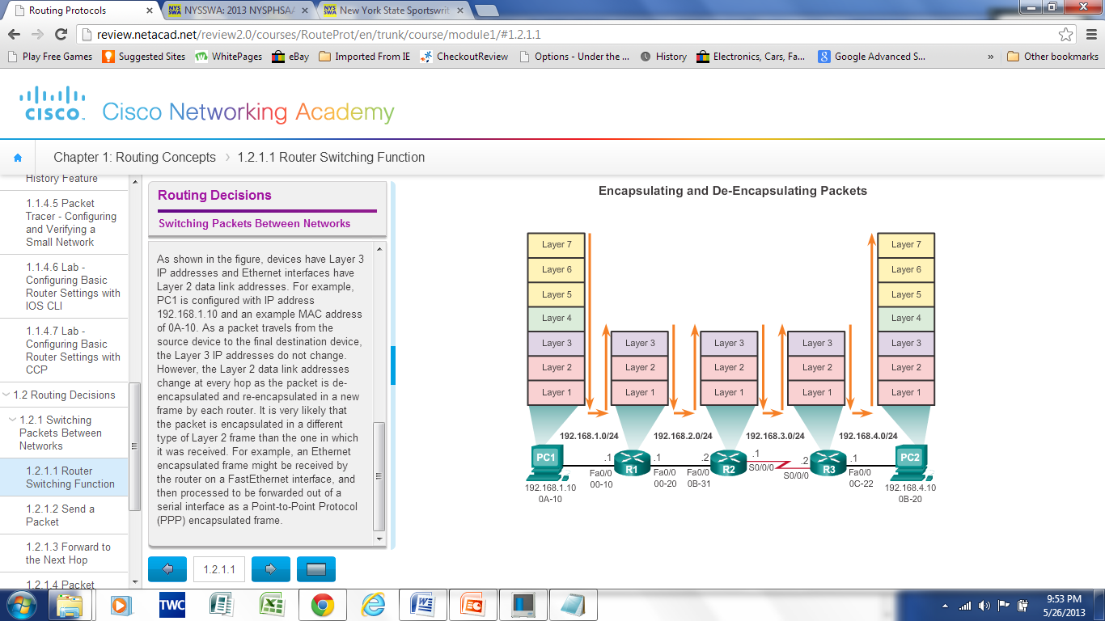
Switching Packets between Networks Router Switching Functions
The primary function of a router is to forward packets toward their destination. This is accomplished by using a switching function, which is the process used by a router to accept a packet on one interface and forward it out of another interface
Notes:
4.2.1 Switching Packets between Networks
4.2.1.1 Router Switching Functions

Slide 32
Switching Packets between Networks Router Switching Functions
What does a router do with a packet received from one network and destined for another network? The router performs the following three major steps:
Step 1. De-encapsulates the Layer 3 packet by removing the Layer 2 frame header and trailer.
Step 2. Examines the destination IP address of the IP packet to find the best path in the routing table.
Step 3. If the router finds a path to the destination, it re-encapsulates the Layer 3 packet into a new Layer 2 frame and forwards the frame out the exit interface.
Notes:
4.2.1 Switching Packets between Networks
4.2.1.1 Router Switching Functions

Slide 33
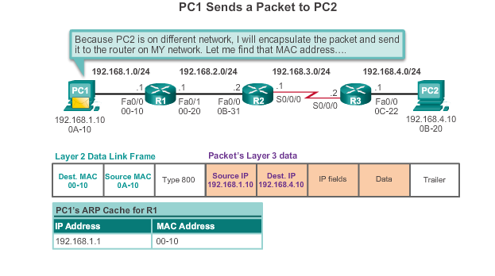
Switching Packets between Networks Send a Packet (1)
Notes:
4.2.1 Switching Packets between Networks
4.2.1.2 Send a Packet

Slide 34
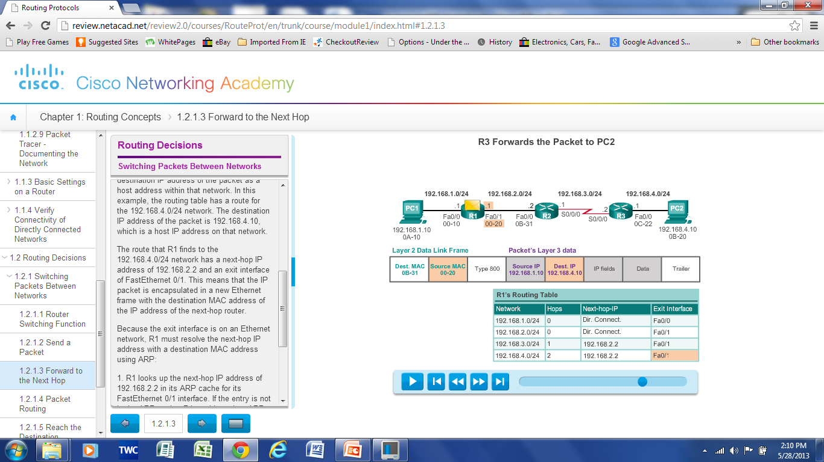
Switching Packets between Networks Forward to the Next Hop (2)
Examine Dest ’IP Address and check the routing Table for a Match
Notes:
4.2.1 Switching Packets between Networks
4.2.1.3 Forward to the Next Hop

Slide 35
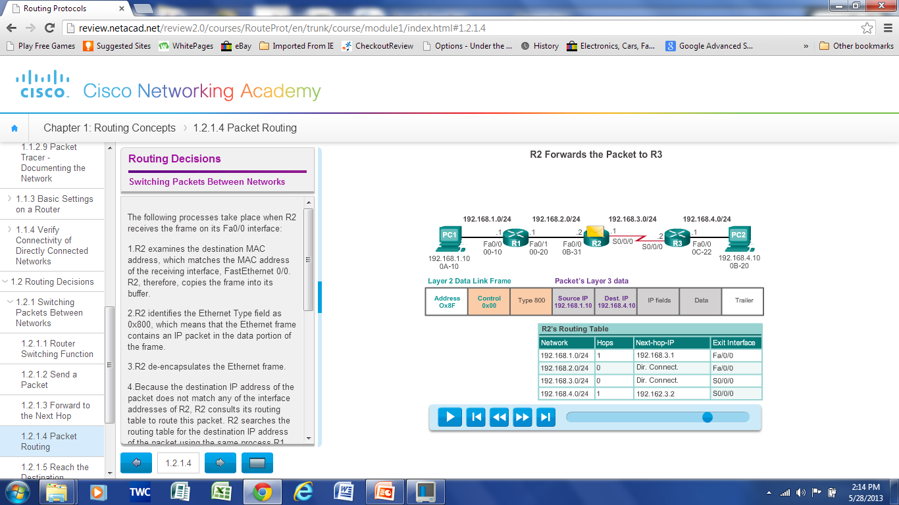
Switching Packets between Networks Packet Routing
Note: When the interface is a point-to-point (P2P) serial connection, the router encapsulates the IPv4 packet into the proper data link frame format used by the exit interface (HDLC, PPP, etc.) i.e. no MAC addresses.
Examine Dest ’IP Address and check the routing Table for a Match
Notes:
4.2.1 Switching Packets between Networks
4.2.1.4 Packet Routing

Slide 36
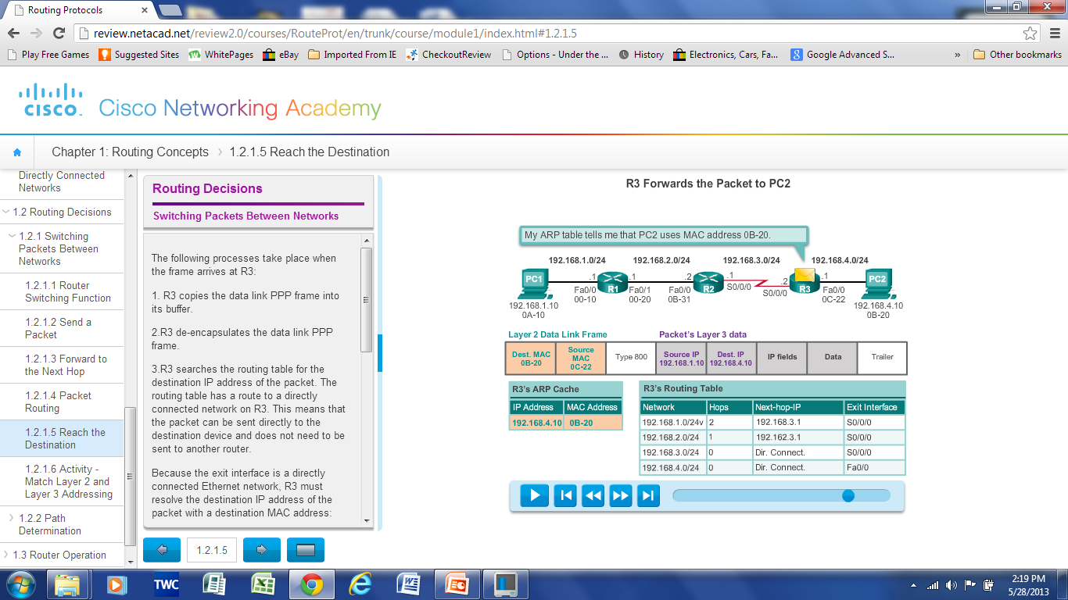
Switching Packets between Networks Reach the Destination
Notes:
4.2.1 Switching Packets between Networks
4.2.1.5 Reach the Destination
4.2.1.6 Activity – Match Layer 2 and Layer 3 Addressing

Slide 37
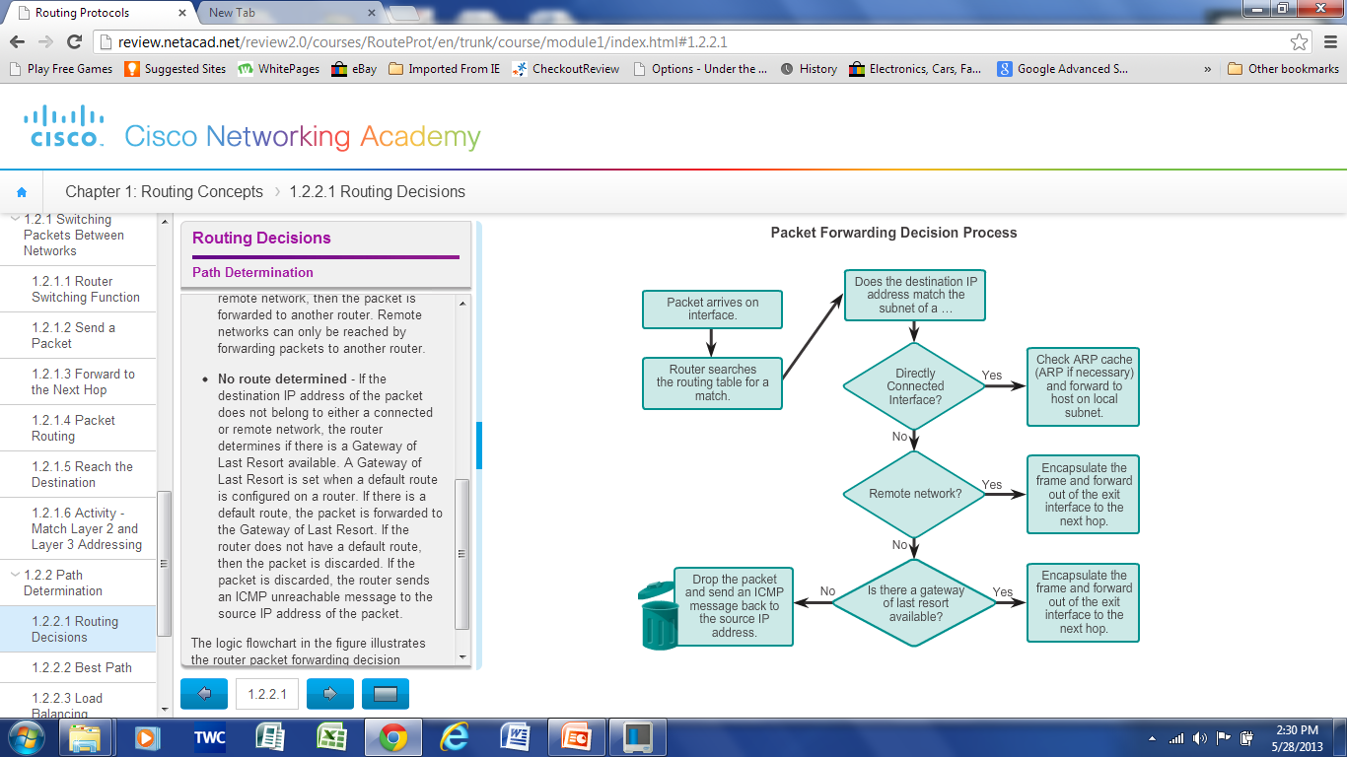
Path Determination Routing Decisions
The routing table search results in one of three path determinations:
Directly connected network.
Remote network
No route determined
If the destination IP address of the packet does not belong to either a connected or remote network, the router determines if there is a Gateway of Last Resort available. A Gateway of Last Resort is set when a default route is configured on a router. If there is a default route, the packet is forwarded to the Gateway of Last Resort. If the router does not have a default route, then the packet is discarded and the router sends an ICMP unreachable message to the source IP address of the packet.
Notes:
4.2.2 Path Determination
4.2.2.1 Routing Decisions

Slide 38
Path Determination Best Path
“Best path” is selected by a routing protocol based on the value or metric it uses to determine the distance to reach a network.
A metric is the value used to measure the distance to a given network.
Best path to a network is the path with the lowest metric.
Dynamic routing protocols use their own rules and metrics to build and update routing tables for example:
Routing Information Protocol (RIP) - Hop count
Open Shortest Path First (OSPF) - Cost based on cumulative bandwidth from source to destination
Enhanced Interior Gateway Routing Protocol (EIGRP) - Bandwidth, delay, load, reliability
Notes:
4.2.2 Path Determination
4.2.2.2 Best Path

Slide 39
Path Determination Load Balancing
What happens if a routing table has two or more paths with identical metrics to the same destination network?
When a router has two or more paths to a destination with equal cost metrics, then the router forwards the packets using both paths equally.
If configured correctly, load balancing can increase the effectiveness and performance of the network. Equal cost load balancing can be configured to use both dynamic routing protocols and static routes.
Notes:
4.2.2 Path Determination
4.2.2.3 Load Balancing

Slide 40
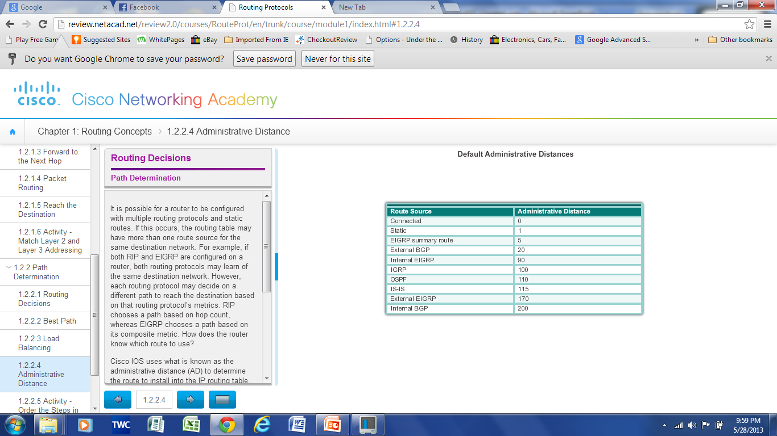
Path Determination of the route Administrative Distance
If multiple paths to a destination are configured on a router, the path installed in the routing table is the one with the best Administrative Distance (AD).
Administrative Distance is the “trustworthiness”
The Lower the AD the more trustworthy the route.
Notes:
4.2.2 Path Determination
4.2.2.4 Administrative Distance

Slide 41
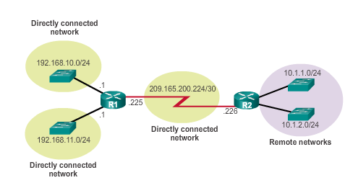
The Routing Table The Routing Table
Routing Table is a file stored in RAM that contains information about
Directly Connected Routes
Remote Routes
Network or Next hop Associations
Notes:
4.3 Router Operation
4.3.1 Analyze the Routing Table
4.3.1.1 The Routing Table

Slide 42
The Routing Table Routing Table Sources
show ip route command is used to display the contents of the routing table
Link local Interfaces (L) –Added to the routing table when an interface is configured. (displayed in IOS 15 or newer)
Directly connected interfaces (C) -Added to the routing table when an interface is configured and active.
Static routes (S) - Added when a route is manually configured and the exit interface is active.
Dynamic routing protocol - Added when RIP or EIGRP or OSPF are implemented and networks are identified.
Notes:
4.3 Router Operation
4.3.1 Analyze the Routing Table
4.3.1.2 Routing Table Sources

Slide 43
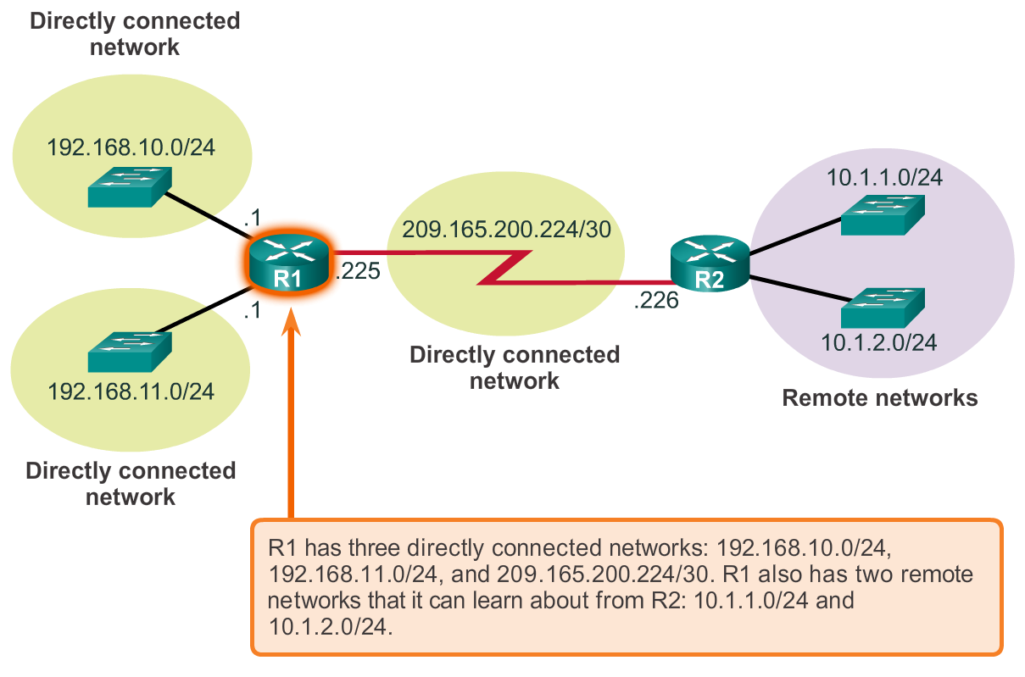
Router Routing Tables Router Packet Forwarding Decision
Notes:
Section 6.2.2.1

Slide 44
Router Routing Tables IPv4 Router Routing Table
192.168.10.0/24
10.1.1.0/24
PC1
.10
G0/0
.1
209.165.200.224 /30
.10
.1
R1
.225
S0/0/0
.226
R2
.10
.1
G0/1
.1
.10
PC2
192.168.11.0/24
10.1.2.0/24
R1#show ip route
Codes: L - local, C - connected, S - static, R - RIP, M - mobile, B - BGP
D - EIGRP, EX - EIGRP external, O - OSPF, IA - OSPF inter area
N1 - OSPF NSSA external type 1, N2 - OSPF NSSA external type 2
E1 - OSPF external type 1, E2 - OSPF external type 2, E - EGP
i - IS-IS, L1 - IS-IS level-1, L2 - IS-IS level-2, ia - IS-IS inter area
* - candidate default, U - per-user static route, o - ODR
P - periodic downloaded static route
Gateway of last resort is not set
10.0.0.0/8 is variably subnetted, 2 subnets, 2 masks
D 10.1.1.0/24 [90/2170112] via 209.165.200.226, 00:00:05, Serial0/0/0
D 10.1.2.0/24 [90/2170112] via 209.165.200.226, 00:00:05, Serial0/0/0
192.168.10.0/24 is variably subnetted, 2 subnets, 3 masks
C 192.168.10.0/24 is directly connected, GigabitEthernet0/0
L 192.168.10.1/32 is directly connected, GigabitEthernet0/0
192.168.11.0/24 is variably subnetted, 2 subnets, 3 masks
C 192.168.11.0/24 is directly connected, GigabitEthernet0/1
L 192.168.11.1/32 is directly connected, GigabitEthernet0/1
209.165.200.0/24 is variably subnetted, 2 subnets, 3 masks
C 209.165.200.224/30 is directly connected, Serial0/0/0
L 209.165.200.225/32 is directly connected, Serial0/0/0
R1#
The routing table stores information about connected and remote networks.
Notes:
Section 6.2.2.2

Slide 45
Router Routing Tables Directly Connected Routing Table Entries
192.168.10.0/24
64.100.0.1
10.1.1.0/24
PC1
.10
G0/0
.1
209.165.200.224 /30
.10
.1
R1
.225
S0/0/0
.226
R2
.10
.1
G0/1
.1
.10
PC2
192.168.11.0/24
10.1.2.0/24
A
B
C
C 192.168.10.0/24 is directly connected, GigabitEthernet0/0
A | Identifies how the network was learned by the router.
B | Identifies the destination network and how it is connected.
C | Identifies the interface on the router connected to the destination network.
Notes:
Section 6.2.2.3

Slide 46
Router Routing Tables Remote Network Routing Table Entries
192.168.10.0/24
64.100.0.1
10.1.1.0/24
PC1
.10
G0/0
.1
209.165.200.224 /30
.10
.1
R1
.225
S0/0/0
.226
R2
.10
.1
G0/1
.1
.10
PC2
192.168.11.0/24
10.1.2.0/24
D 10.1.1.0/24 [90/2170112] via 209.165.200.226, 00:00:05, Serial0/0/0
A | Identifies how the network was learned by the router. (D=EIGRP)
B | Identifies the (remote) destination network.
C | Identifies the administrative distance (trustworthiness) of the route source.
D | Identifies the metric to reach the remote network.
E | Identifies the next hop IP address to reach the remote network.
F | Identifies the amount of elapsed time since the network was discovered.
G | Identifies the outgoing interface on the router to reach the destination network.
Notes:
Section 6.2.2.4

Slide 47
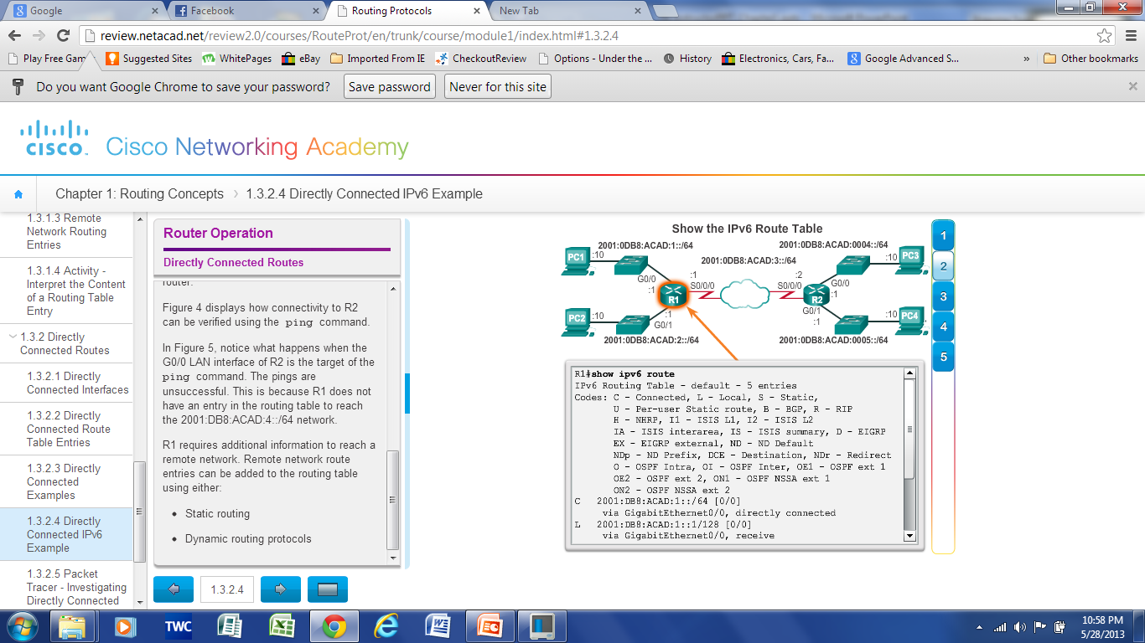
Directly Connected Routes Directly Connected IPv6 Example
The show ipv6 route command shows the ipv6 networks and routes installed in the routing table
Notes:
4.3 Router Operation
4.3.2 Directly Connected Routes
4.3.2.4 Directly Connected IPv6 Example
4.3.2.5 Packet Tracer – Investigating Directly Connected Routes

Slide 48
Statically Learned Routes Static Routes
Manually configured
Define an explicit path between two networking devices.
Must be manually updated if the topology changes.
Benefits include improved security and control of resources.
Static route to a specific network.
ip routenetworkmask {next-hop-ip | exit-intf}
Default Static Route used when the routing table does not contain a path for a destination network.
ip route 0.0.0.0 0.0.0.0 {exit-intf | next-hop-ip
Notes:
4.3 Router Operation
4.3.3 Statically Learned Routes
4.3.3.1 Static Routes

Slide 49
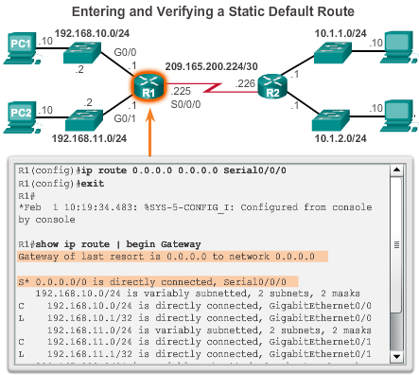
Statically Learned Routes Static Routes Example
Notes:
4.3 Router Operation
4.3.3 Statically Learned Routes
4.3.3.2 Static Routes Examples

Slide 50
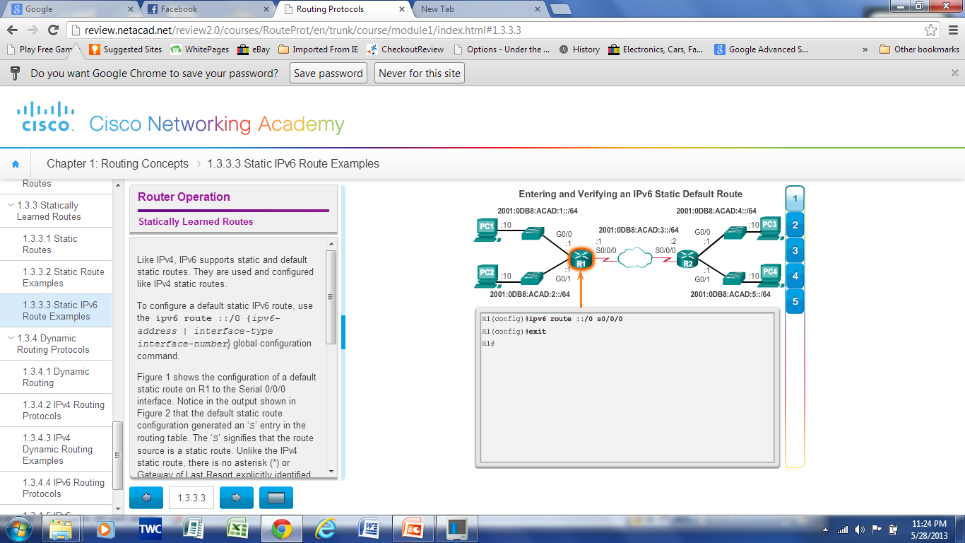
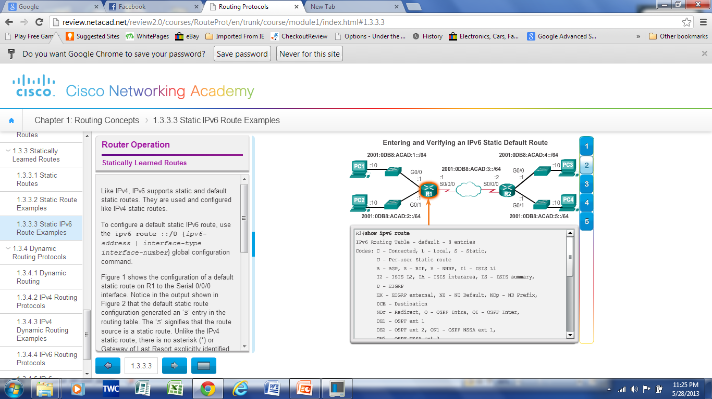
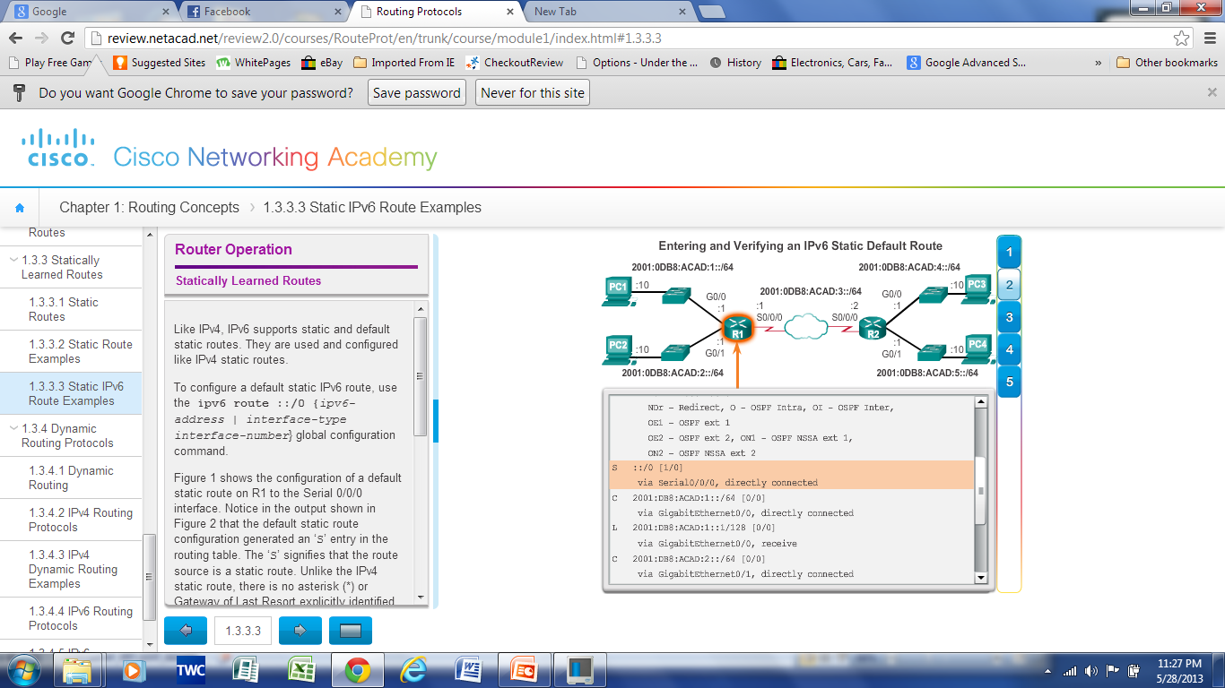
Statically Learned Routes Static IPv6 Routes Example
Notes:
4.3 Router Operation
4.3.3 Statically Learned Routes
4.3.3.3 Static IPv6 Route Example

Slide 51
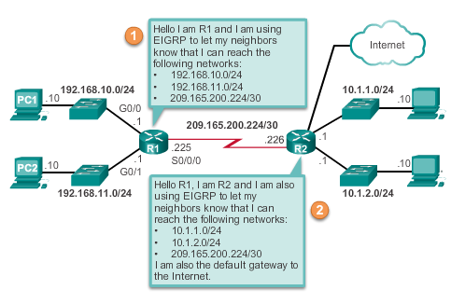
Dynamic Routing Protocols Dynamic Routing
Used by routers to share information automatically about the reachability and status of remote networks.
Performs network discovery and maintaining routing tables.
Notes:
4.3 Router Operation
4.3.4 Dynamic Routing Protocols
4.3.4.1 Dynamic Routing

Slide 52
Dynamic Routing Protocols IPv4 Routing Protocols
Cisco ISR routers can support a variety of dynamic IPv4 routing protocols including:
EIGRP – Enhanced Interior Gateway Routing Protocol
OSPF – Open Shortest Path First
IS-IS – Intermediate System-to-Intermediate System
RIP – Routing Information Protocol
Notes:
4.3 Router Operation
4.3.4 Dynamic Routing Protocols
4.3.4.2 IPv4 Routing Protocols

Slide 53
Dynamic Routing Protocols IPv6 Routing Protocols
Cisco ISR routers can support a variety of dynamic IPv6 routing protocols including:
RIPng (RIP next generation)
OSPF v3
EIGRP for IPv6
MP-BGP4 (Multicast Protocol-Border Gateway Protocol)
Notes:
4.3 Router Operation
4.3.4 Dynamic Routing Protocols
4.3.4.4 IPv6 Routing Protocols

Slide 54


